Slide 1
Safety Checks for Commercial Vehicles
Sparking Ninjas

Slide 2
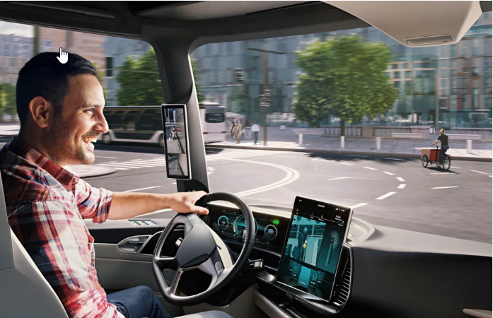
Problem Statement and Solution
Problem Statement:
Safety measures for commercial vehicles
Idea/Solution: Software to ensure commercial vehicles follow mandatory checks during ignition and when the vehicle is in motion

Slide 3

Checklist
Software Check to ensure safety
On Ignition:
Seatbelt mandatory for all(only if passenger load is detected)
Maximum seating capacity check
Driver Authentication
Driver Drowsiness Check and alcohol odor detecting
Doors should be closed
After Ignition:
Doors should be closed
Driver Alertness Monitoring
Speed and Geo-Fencing

Slide 4

Leveraging existing solutions
Software Check to ensure safety
Nissan: Developed an alcohol odor-detecting steering wheel.
Volvo: Uses in-cabin cameras and AI to detect drowsiness and drunkenness.
Tesla: Monitors driver’s eye movement via cameras to ensure attentiveness.

Slide 5
Roles and Responsibilities
Software Check to ensure safety
Arthi K Mohan – Test Automation
Nandhini R – Data analysis
Dinesh B – Software development
Durai M – Test Automation
Visnu – Software development
Viveka- Architect

